Slide 1
Topic: Measurement
EQ: How do I Calculate the Volume of rectangular Prisms?
Year 7 Mathematics

Slide 2
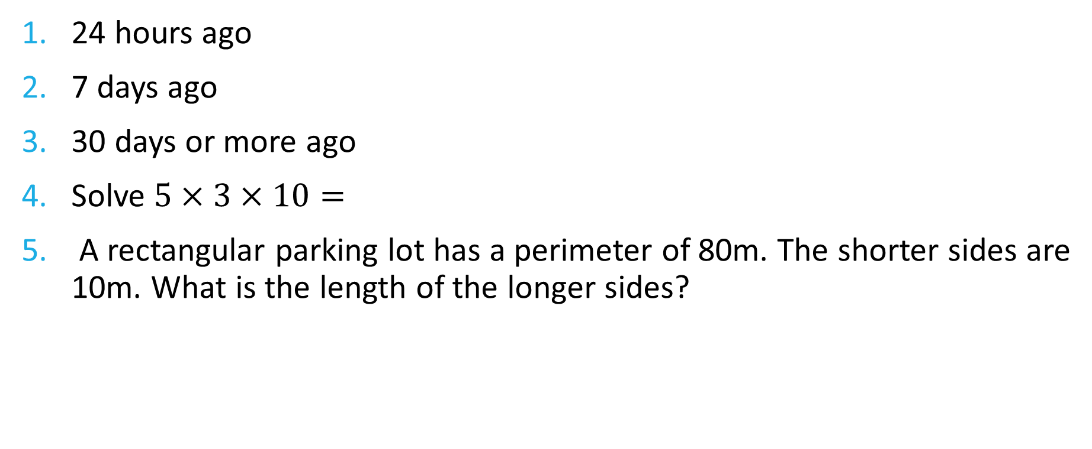
Five Questions (LHS)
Topic: Measurement
EQ: How do I calculate the volume of rectangular prisms?
Date: XX/XX/2021
24 hours ago
7 days ago
30 days or more ago
Solve $5×3×10=$
A rectangular parking lot has a perimeter of 80m. The shorter sides are 10m. What is the length of the longer sides?

Slide 3
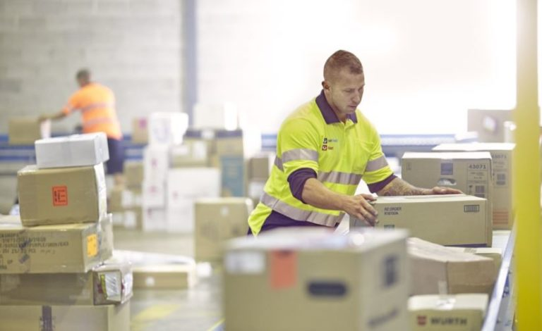
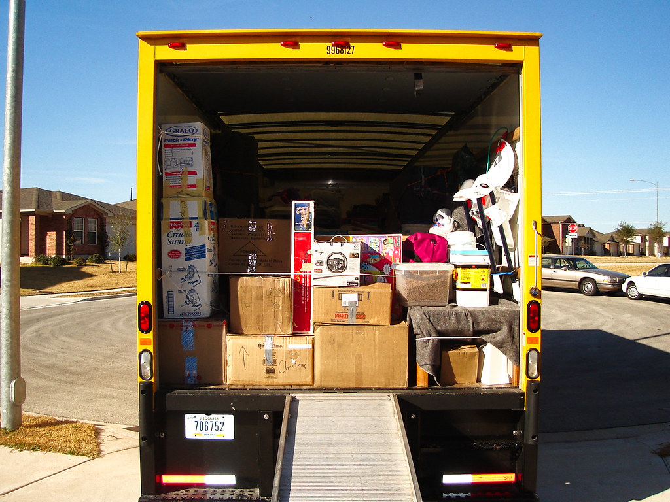

24
7
30
Topic: Measurement
Date: XX/XX/2021
EQ: How do I calculate the volume of rectangular prisms?
What is volume?
Volume is the amount of space that is occupied in three dimensions.
It is measured in km³, m³, cm³, and mm³.
Examples
Parcel Post (cm³)
Moving house (m³)
Atmosphere (km³)
This Photo by Unknown Author is licensed under CC BY-SA

Slide 4
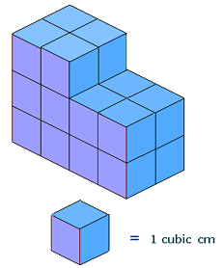
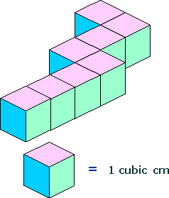
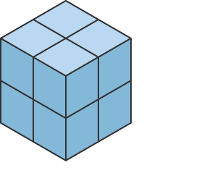
24
7
30
Topic: Measurement
Date: XX/XX/2021
EQ: How do I calculate the volume of rectangular prisms?
How do I find the volume?
How would I find the volume of the following three shapes?
One method is to count all the blocks.
8
20
8

Slide 5
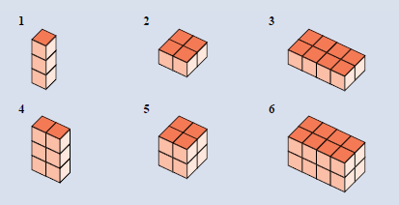
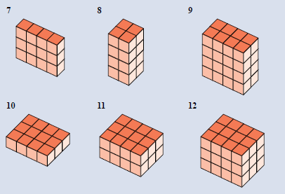
Task
Find the volume of the following blocks

Slide 6
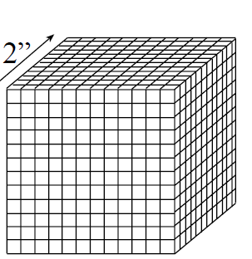
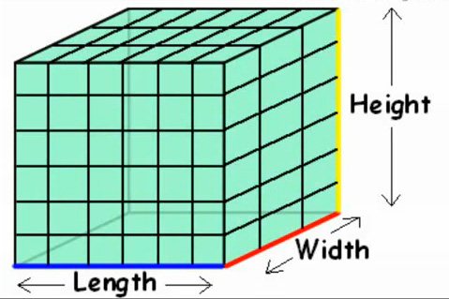
24
7
30
Topic: Measurement
Date: XX/XX/2021
EQ: How do I calculate the volume of rectangular prisms?
How do I calculate volume?
Is there an easier way than just counting blocks?
Imagine counting all these blocks.

Slide 7
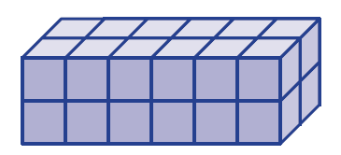
24
7
30
Topic: Measurement
Date: XX/XX/2021
EQ: How do I calculate the volume of rectangular prisms?
How do I calculate the volume of a rectangular prism or cube?
$$Volume = Length × Width × Height$$
Example: Calculate the volume of this rectangular prism. Each cube is 1 cm³.
2 cm
2 cm
6 cm

Slide 8
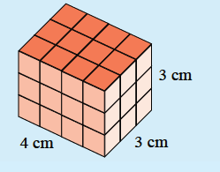
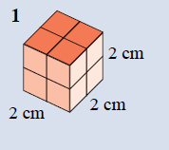
Examples
$$Volume = Length × Width × Height$$

Slide 9
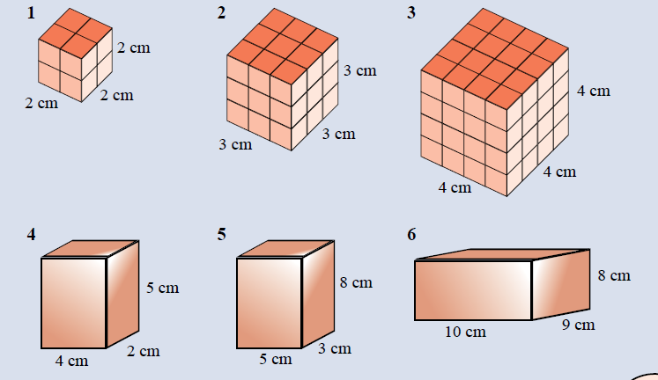
Task

